Slide 1
Comparatives using as…as…
Basic 12

Slide 2
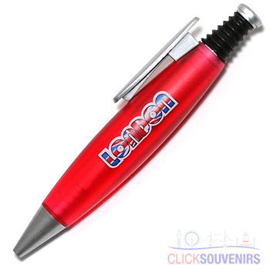
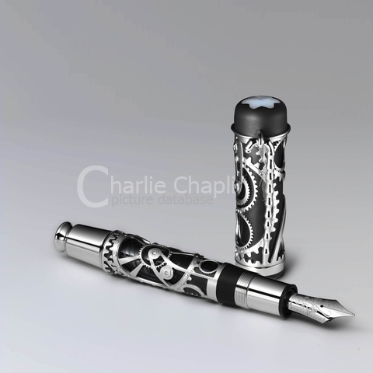
A is as useful as B
A is not as big as B
A is not as cheap as B
A works as well as B
B is as useful as A
B is not as new as A
B is not as expensive as A
B is not as nice as A
B
A
New - Nice - Expensive
Old - Cheap - Big

Slide 3
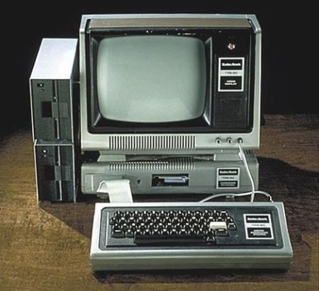
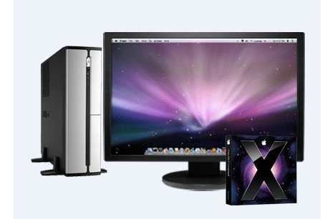
MAC
HP
New
Fast
Efficiently
Old
Slow
Inefficient
The Mac is not as slow as the HP.
It is not as fast as the Mac.
It is not as efficient as the Mac.

Slide 5
Dan's house
Tom's house

Slide 6


Rule 2:
Jan
Julie

